Slide 1


The fully autonomous job-search assistant.
Offerloop finds the roles, finds the people, writes the outreach in your voice, and tracks every conversation, so you land better offers, faster.
Presented by
[Your name]
· Offerloop Campus Ambassador
Notes:
Hey everyone, I'm your Offerloop campus ambassador. Offerloop is a fully autonomous job-search assistant, and in the next five minutes I'm going to show you why you need it and get it running on your own laptop. Open Chrome and follow along.

Slide 2
THE JOB SEARCH TODAY
Apply. Wait. Get ghosted. Repeat.
→
→
→
01
02
03
04
Find a posting
Submit & hope
Wait weeks
Silence
Scroll job boards for hours looking for a fit.
You're application #4,000 in a stack of 12,000.
An algorithm screens you before a person ever does.
No reply. Back to square one.
Applying harder doesn't fix this.
Notes:
Here's how the search usually goes. You find a posting, you tweak your résumé, you hit submit, and then nothing. You're application number four thousand in a stack of twelve thousand, and no human ever sees it. Applying harder doesn't fix this. The résumé pile is not where you win.

Slide 3
































THE REALITY OF THE JOB MARKET
12,000
applicants for the average entry-level role , at the 50 biggest companies in the world.
So how do you stand out?
Notes:
Let's start with a number. The average entry-level role at one of the 50 biggest companies in the world gets around twelve thousand applicants. Twelve thousand. These are the logos on this wall, the places you actually want to work. So sending in a résumé and hoping? You're one in twelve thousand. The real question is: how do you stand out?

Slide 4
52×
You don't stand out on paper. You stand out through people.
more likely to get hired through a referral or personal connection
Referrals and warm intros are the real front door. The people who land the offer aren't the best applicants, they're the ones who built a connection first.
<1%
of job seekers actually get a referral before they apply
Notes:
So how do you actually get in? Through people. You are 52 times more likely to get hired through a referral or a personal connection than a cold application. But here's the catch, fewer than one percent of applicants ever get that referral. The people who win aren't the best applicants. They're the ones who built a connection first.

Slide 5
BUT CONNECTING TAKES TIME
A recruiting cycle eats 200 hours of your life.
180 of those 200 hours is busywork a computer could do. Offerloop does it in minutes.
80h
50h
40h
20h
10h
Outreach
Research
Applications
Tracking
180h of busywork, automated
Interviews
15 min to write one personalized email
2 hrs of work for a single reply
Notes:
Okay, so build connections. Easy to say, but doing it by hand is brutal. It's 15 minutes to write one good personalized email, and about two hours of work for every reply you get back. A full recruiting cycle is roughly 200 hours, and 180 of those hours is pure busywork, outreach, research, applications, tracking. That's the problem Offerloop was built to erase.

Slide 6
Scout
Your fully autonomous copilot.
Notes:
So how does Offerloop actually do all of this? Meet Scout, your fully autonomous copilot. This little guy does the busywork so you can focus on the conversations.

Slide 7

Ask Scout
MEET SCOUT · YOUR COPILOT
Hey, go ahead and apply to all 15.
Just describe what you're after.
On it, applying to 15 matched roles now...
MW
Technology Intern
Applied
Marshall Wace
Tell Scout what you want in plain English: a role, a company, a person. It does the busywork of finding the people, writing the outreach, and tracking every conversation.
1X
AI Residency Intern
Applied
1X
Ai
Growth Account Executive
Applied
Airbyte
Jobs
Hiring managers
People
Companies
+ 12 more in queue...
Ask Scout anything...
THE DATA ENGINE
2.2B contacts
3M+ recruiters
300K live jobs
Notes:
This is where Offerloop comes in. You just tell Scout what you want in plain English, a role, a company, a person, and it does the busywork: finding the people, writing the outreach, tracking every conversation. Watch, you say go apply to all 15, and it just does it, pulling from a data engine of 2.2 billion contacts.

Slide 8
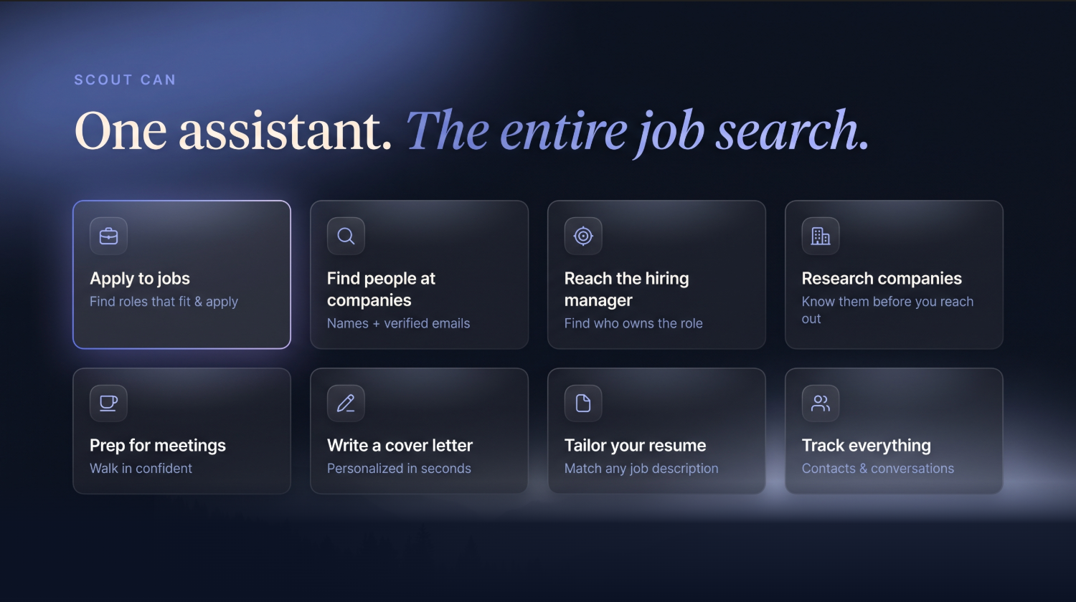
Notes:
And here's the fun part, everything Scout can do. Apply to jobs, find people at companies with verified emails, reach the hiring manager who owns the role, research companies before you reach out, write cover letters in seconds, tailor your resume, prep you for meetings, and track every conversation. One assistant, the entire job search.

Slide 9
IN THEIR WORDS
From zero to a FedEx offer in one month.
“Probably sent 500 emails with this thing. Couldn't imagine doing that myself.”
Luke Brooks
DJ
David Ji
Junior · International Relations · USC
“It made me much more confident and productive. Started landing interviews weeks after using it.”
1 month
Tons
Dylan Roby
from first use to offer
of coffee chats secured
Notes:
And it works. David Ji, a junior right here at USC, went from first opening Offerloop to a FedEx offer in one month, with tons of coffee chats along the way. Students have sent hundreds of emails they'd never have sent by hand. This is real, and it's growing fast.

Slide 10
DO IT WITH ME
Grab your laptop. Let's set up Scout.
Two steps, about sixty seconds. Open Chrome and follow along.
1
Add the extension
2
Create your account
Notes:
Okay, enough from me. Let's get Scout on your laptop right now. Everyone open Chrome. Two quick steps: add the extension, then create your account. Takes about a minute and we'll do it together, I'll wait for everyone.

Slide 11
01
STEP ONE
Add the extension
1
Open the Chrome Web Store
QR CODE
2
Search “Offerloop”, look for the loop mark
3
Click Add to Chrome → Add extension, then pin it
Scan to open the Web Store
Notes:
Step one, add the extension. Open a new tab, go to the Chrome Web Store, and search Offerloop. We're the one with the loop mark. Click Add to Chrome, then Add extension on the popup, and pin it to your toolbar. Give me a thumbs up when you see the loop icon up there.

Slide 12
02
STEP TWO
Create your account
1
Go to offerloop.ai and click Sign up
QR CODE
2
Use your school email and connect Gmail
3
You're in, free to start. Say hi to Scout
Scan to sign up at offerloop.ai
Notes:
Step two, create your account. Head to offerloop.ai and sign up with your school email. Connect your Gmail so Scout can draft right in your inbox, and you're in. Free to start. Thumbs up when you land on the dashboard.

Slide 13

WATCH IT WORK
Now the fun part, do it with me.
1
Capture a contact from a profile, one click
2
Draft a personalized email in your voice
3
Send it via Gmail, then try it yourself
Notes:
Now let's actually use it. Watch my screen. I'll tell Scout what I'm after, capture a real contact in one click, have it draft a personalized email in my voice, and send it via Gmail, live. Then try it yourself: pick one person you'd genuinely want to reach and run it.

